Slide 1
Safe regression test selection for Modelica
By Erik Hedblom and Kasper Rundquist
Notes:
Presentera oss och projektet

Slide 2
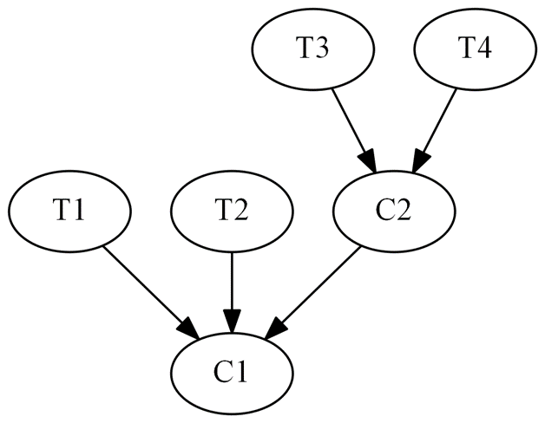
Safe test selection
Notes:
Safe: garantera att alla tester som skulle kunna misslyckas faktiskt körs
Naiv metod: kör alla tester
Lång tid att köra alla tester

Slide 3


Modelon
Jmodelica.org
OPTIMICA Compiler Toolkit
Model Testing Toolkit
Notes:
Modelon
Jmodelica/OCT
MTT

Slide 4
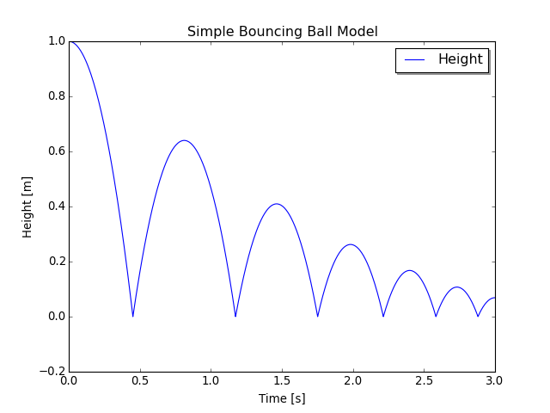
Modelica Bouncing Ball example
model BouncingBall
parameter Real e = 0.8;
parameter Real g = 9.81;
Height h(start=1);
Velocity v(start=0);
equation
der(h) = v;
der(v) = -g;
when h <= 0 then
reinit(v, -e*pre(v));
end when;
end BouncingBall;
Notes:
Beskriv Modelica
Deklarativt, objektorienterat
Vad används Modelica till?
Modellera komplexa fysikaliska system.
Modeller beskrivs mha ekvationer
Beskriv exemplet

Slide 5
Dependency rules
A class depends on all classes referenced by resolvable accesses within it, not including accesses within paths.
A class depends on its enclosing class.
A class depends on all classes referenced by access paths within it. A unresolvable access can still contain resolvable accesses within its path.
A class depends on all classes enclosed by an accessed class. This does not include access within paths but if an access is not resolvable, the last resolvable access in the path will be used instead.
Exception to Rule 4: Rule 4 is not applicable to import statements.
Notes:
Vi har utvecklat 5(4) regler för att skapa en beroende graf.

Slide 6
Dependency rules
A class depends on all classes referenced by resolvable accesses within it.
package P
model M1
constant k1 = 0;
end M1;
model M2
M1 m1;
end M2;
end P;
package P
model M1
constant k1 = 0;
end M1;
model M2
M1 m1;
constant k2 = m1.k1;
end M2;
end P;
Notes:
Beskriv regel 1
Visa att vi inte kan slå upp m1.k1 till höger
Säg något om namnuppslagning

Slide 7
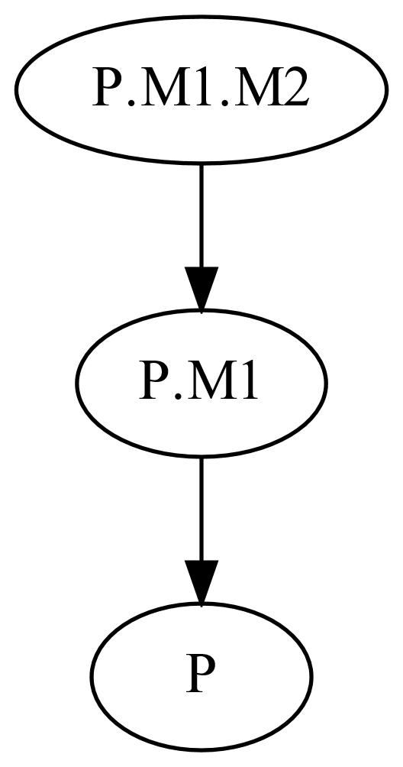
Dependency rules
2. A class depends on its enclosing class.
package P
constant Real k = 1;
model M1
model M2
Real x = k;
end M2;
end M1;
end P;
Notes:
Regel 2

Slide 8
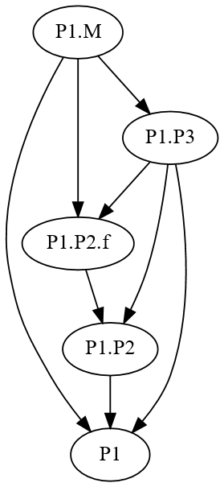
Dependency rules
3. A class depends on all classes referenced by access paths within it. A unresolvable access can still contain resolvable accesses within its path.
package P1
package P2
function f
input Real x;
output Real y;
algorithm
y := x;
end f;
end P2;
package P3
extends P2;
end P3
model M
Real x = P3.f(0);
end M;
end P1;

Slide 9
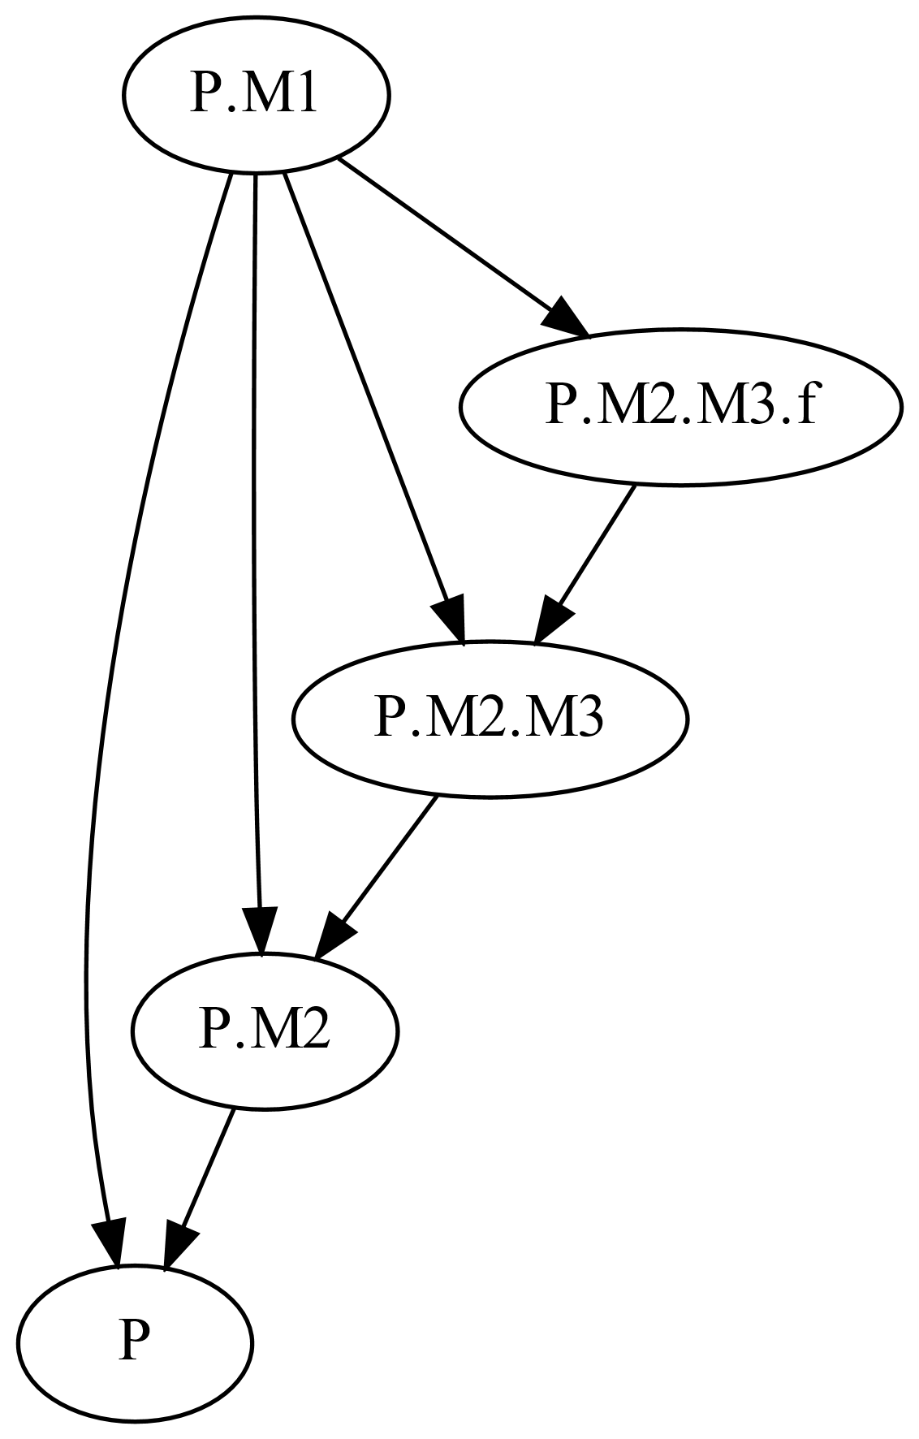
Dependency rules
4. A class depends on all classes enclosed by an accessed class.
package P
model M1
M2 m;
Real r = m.M3.f(1);
end M1;
model M2
model M3
function f
input Real x;
output Real y;
algorithm
y := x;
end f;
end M3;
end M2;
end P;

Slide 10
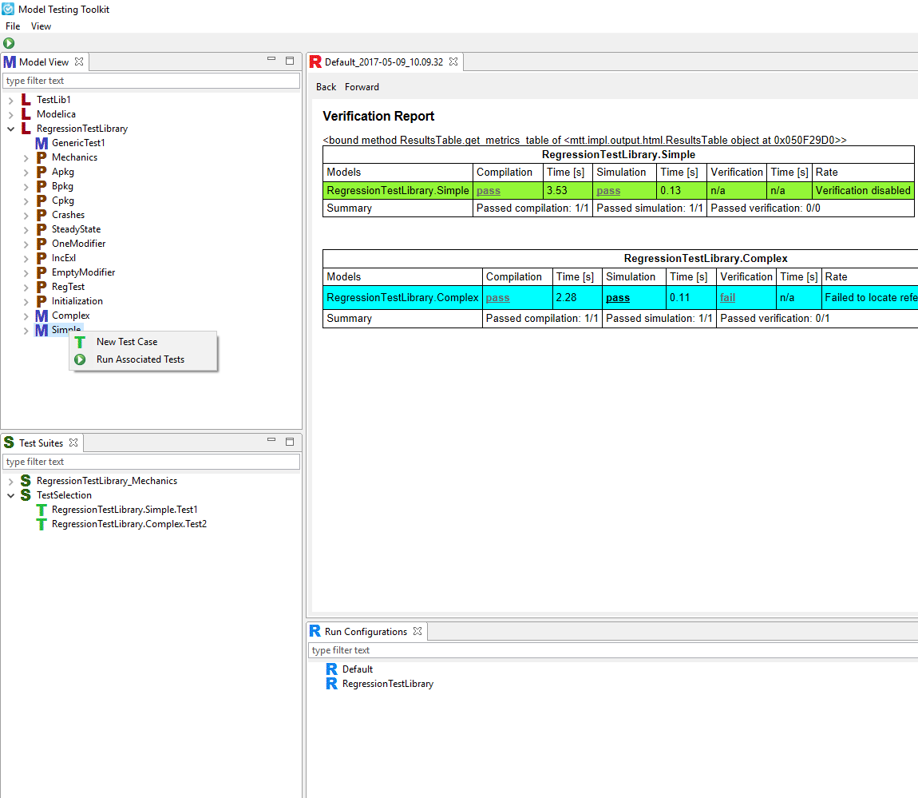
Implementation
Notes:
External functions
Change detection

Slide 11
Evaluation

Slide 12
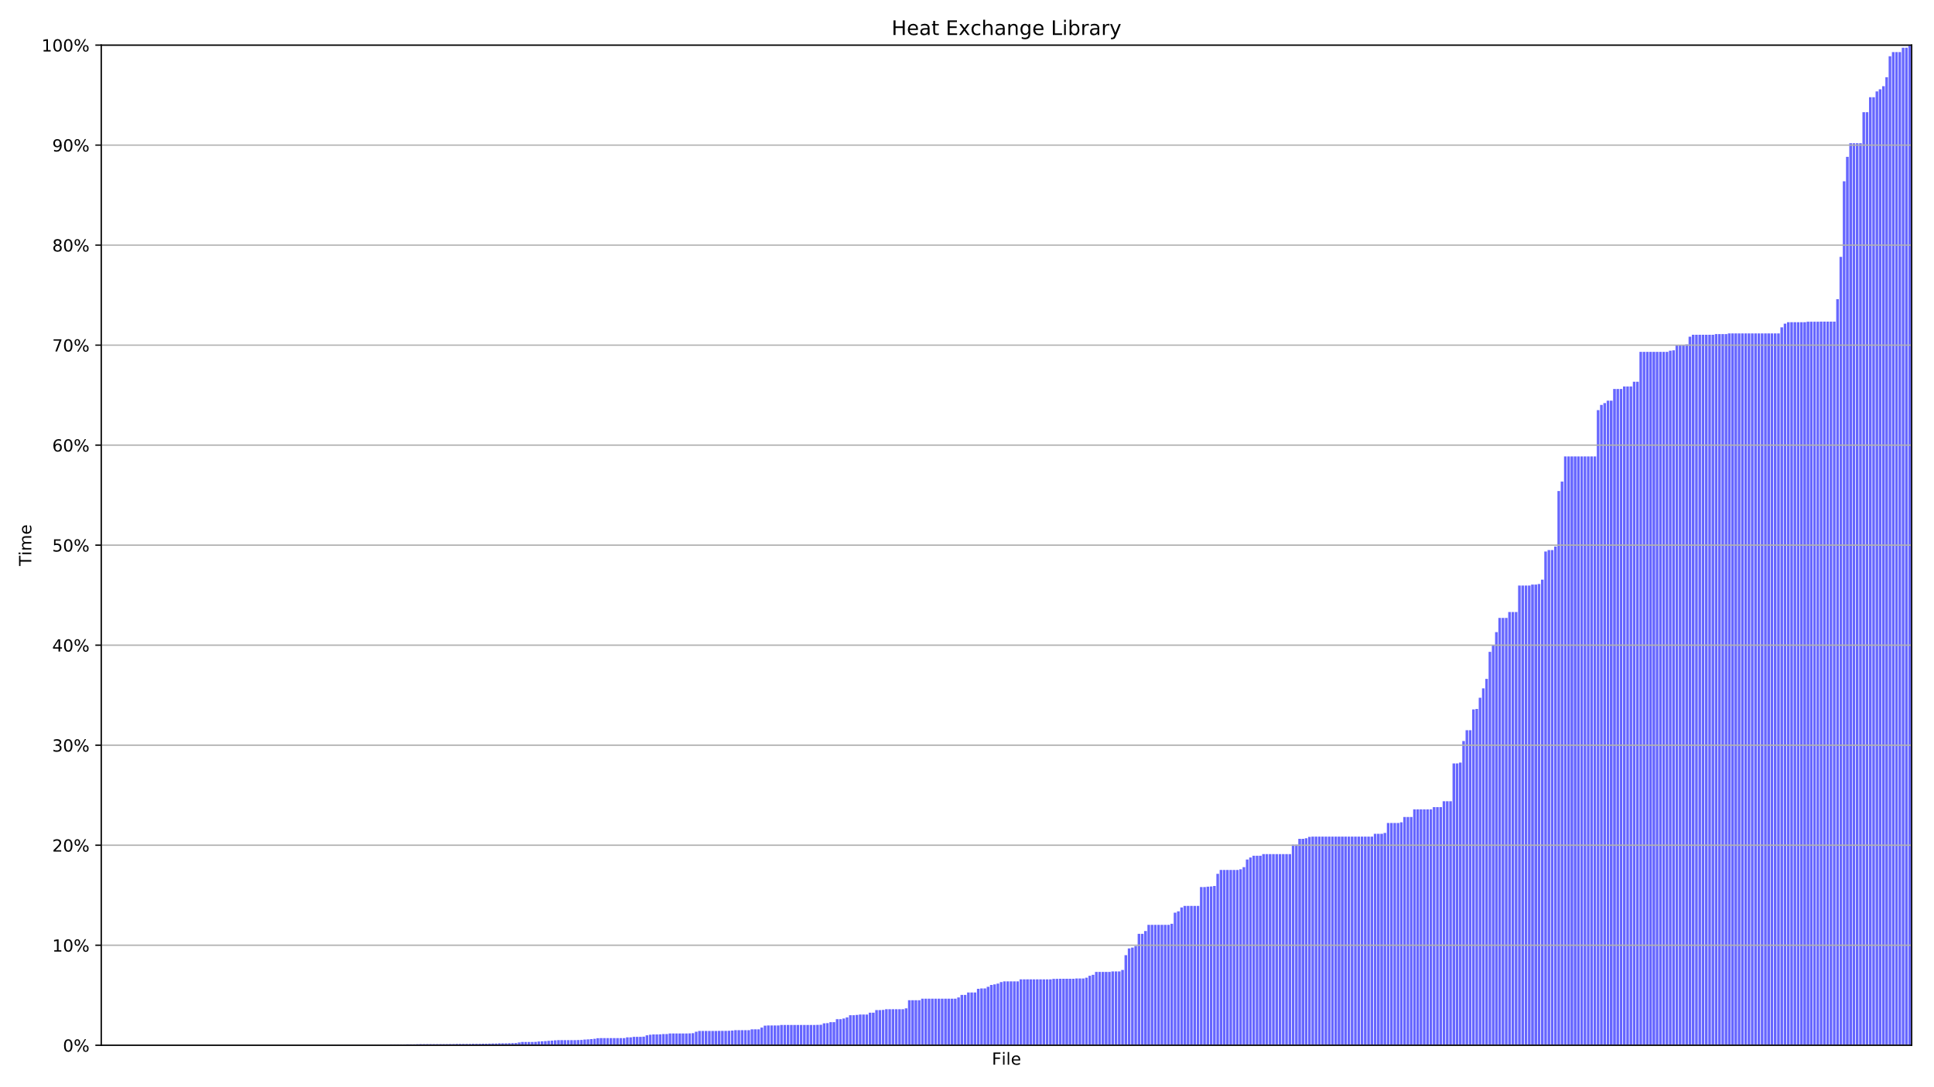
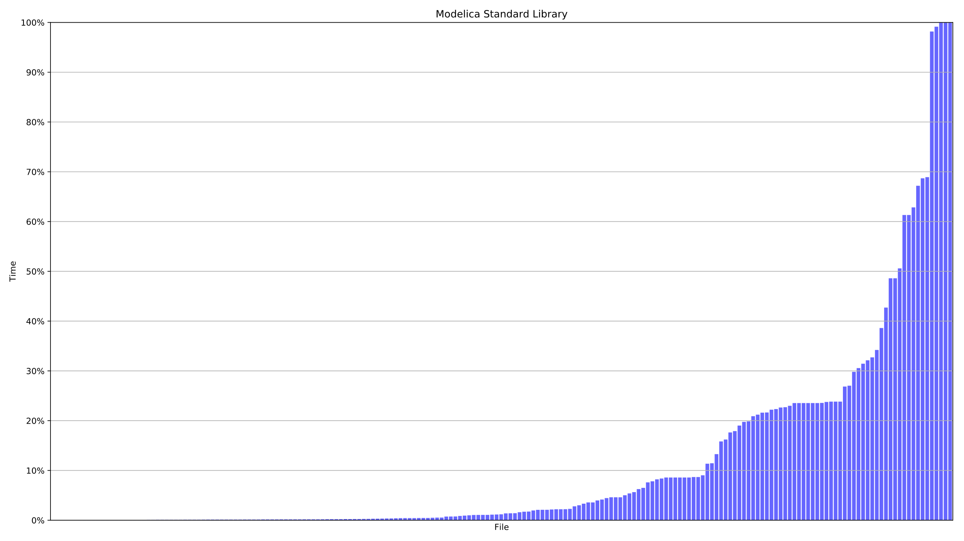
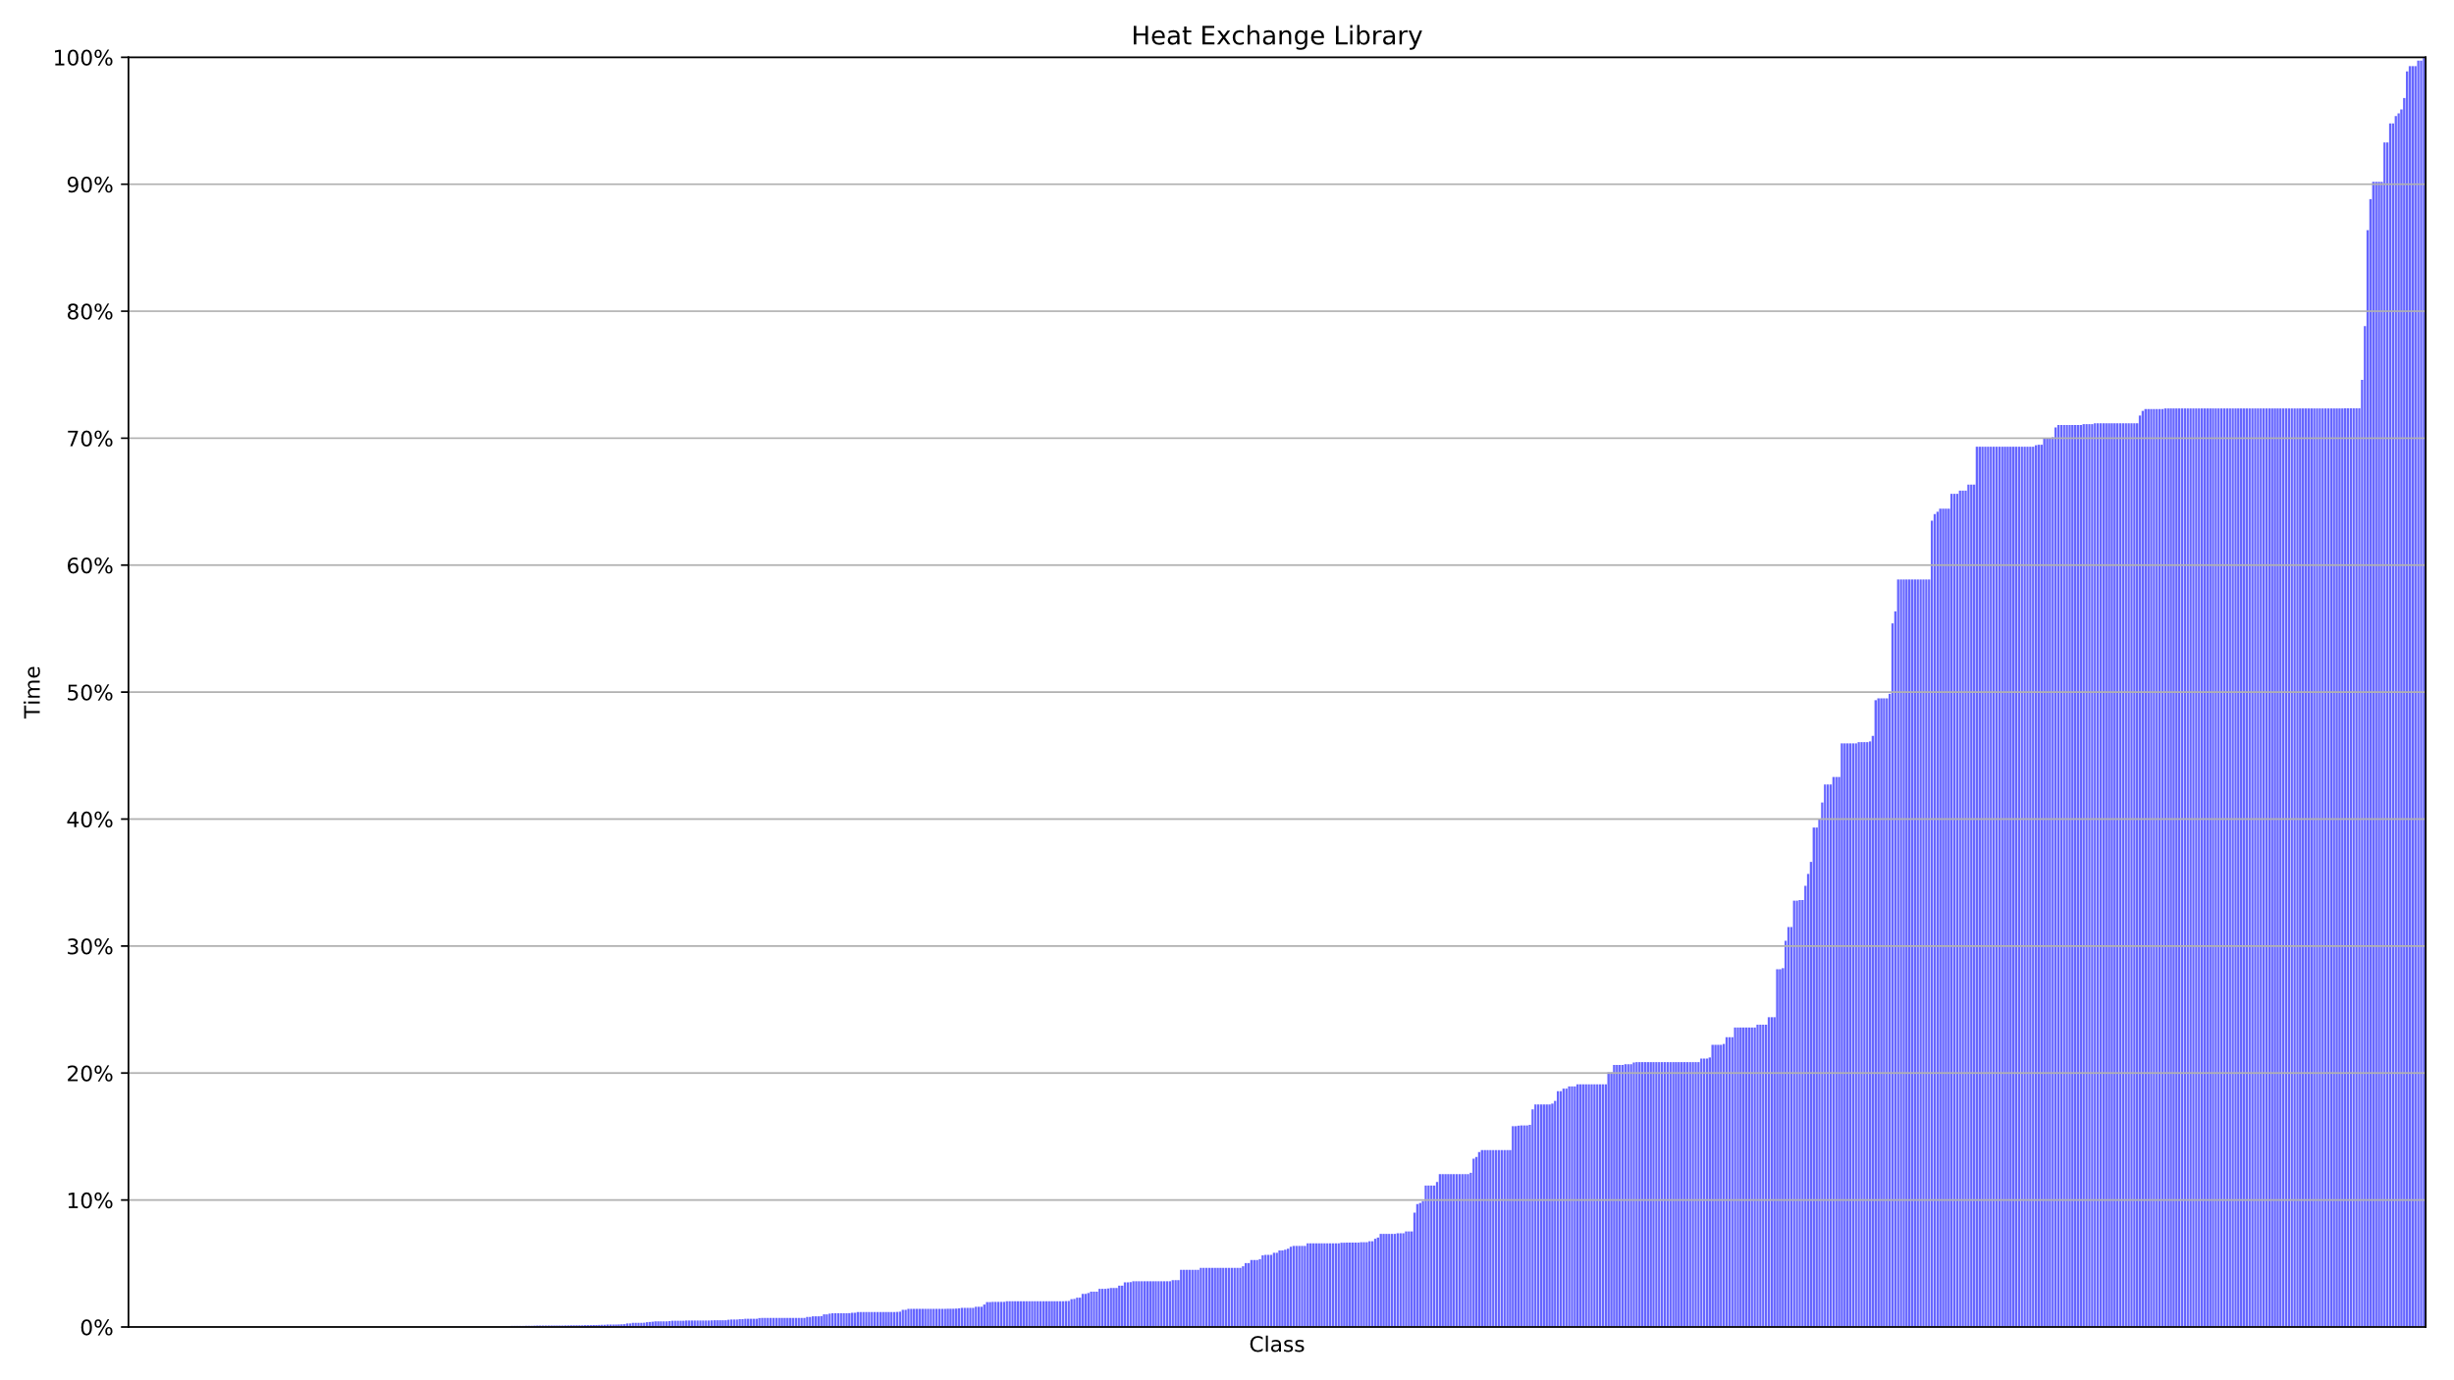
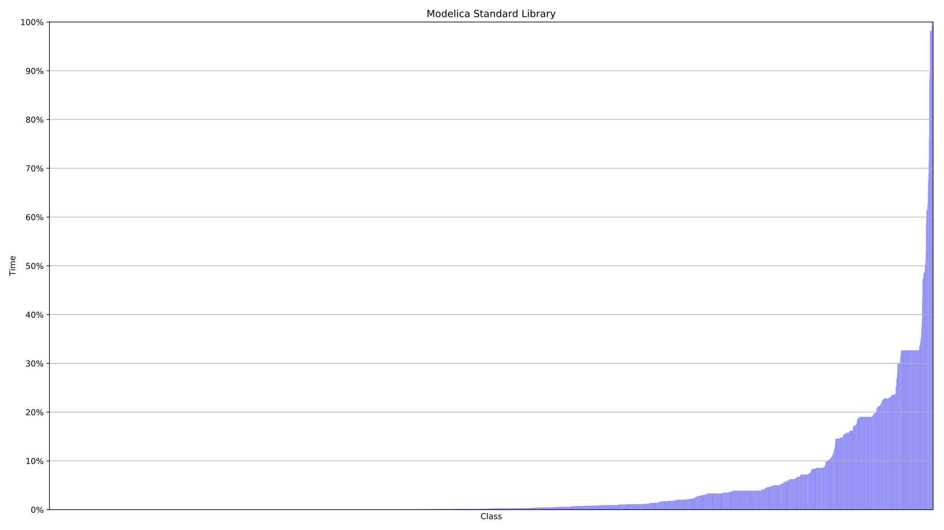
Resultat filer och klasser
Notes:
Beskriv graferna
Besgränsningar
Kapat tester efter 10 min
Inkluderar inte tiden för beroende analysen

Slide 13
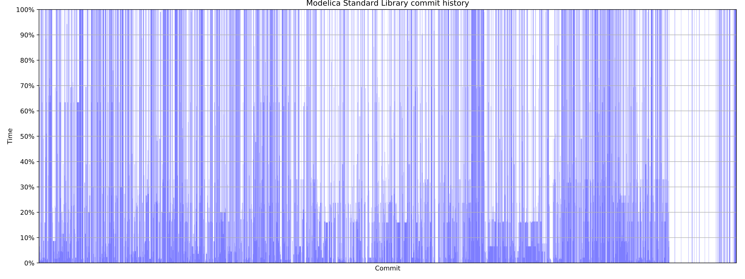
Evaluation
Notes:
Beskriv grafen, ett mer realistiskt användingsfall
En approximation
Vi har inte kört om analysen för varje kommit
Inkluderar inte analys tiden

Slide 14
Evaluation
 | Units | Complete testsuite execution time | Dependency analysis exectution time | Average time savings
HXL | 552 files | 3h 1m 51s | 6.7s | 68%
 | 819 classes |  |  | 67%
MSL | 197 files | 2h 26m 36s | 18.8s | 88%
 | 5917 classes |  |  | 93%
 | 4341 commits |  |  | 56%
Notes:
Sammanfatta våra resultat

Slide 15
Validation/Future work
Run testselection in paralell with complete testsuite
Mutation testing
Move implementation to instance tree?
Notes:
Validering
Vi har utvecklat en test svit, delvis genom att köra analysen på MSL och manuellt jämföra resultatet
Vi har kontinuerligt under arbetets gång diskuterat vår analys med Jesper och Jonathan på Modelon.
Future work
More validation
Instance tree

Slide 16
Questions?

